Slide 1
Welcome to FeatureCAM
Training
Geometry & Curves

Slide 2
Agenda
Session 1
Geometry
Snapping
Lines
Circles
Arcs
Fillets
Dimensions
Session 2
Curves
1. Closed Curves
2. Pick Pieces
3. Curve Wizard intro
4. Troubleshooting curves
Importing Geometry
1. Chaining Imported Geometry
2. Layering Basics

Slide 3
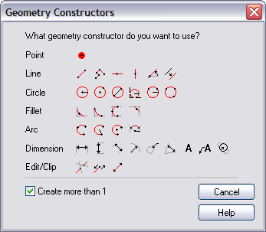

Geometry Step
Nearly all 2D geometry constructors are available from the Geometry Step
Click Create more than 1 to stay in this mode

Slide 4
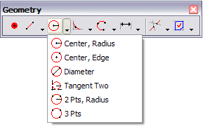
Flyout Menus
Also available from Geometry toolbar
  Contains flyout menus
Click on the triangle to reveal the menu
Last item selected is displayed in the tool bar.
Used throughout FeatureCAM
Notes:
(Explain how to display a toolbar from the View menu.
Open the program, display the geometry toolbar and select items showing how the most recently selected button comes to the top.)

Slide 5


Snapping
Controls how points you are selecting with the mouse are “attracted” to locations on the screen
Controlled by Snap mode toolbar
Snap Discrimination Dialog
Grid
Endpoint
Section
Center
Object
Point
Midpoint
Intersection
Quadrant
Tangent

Slide 6
Snap Modes
Point snaps to a point object.
Endpoint and midpoint snap to the ends and middle points of finite lines and arcs. Endpoint also applies to the corners of the stock.
Section snaps equal intervals of a finite line. The number of sections is controlled by the Sections parameter of the Snapping Grids dialog box.
Intersection snaps to the intersection of lines, arcs and circles.
Center snaps to circle centers. This setting also controls the display of circle and arc center points.

Slide 7
Snapping Continued
Quadrant snaps to the four points on a circle corresponding to 0°, 90°, 180° and 270°.
Tangent snaps the point so that the object you are creating will be tangent to the object you snapped to.
Object snaps to a point on another object. This includes lines of surfaces and is convenient for snapping points to locations on a surface.
Snap discrimination dialog displays a dialog box if the point you select could snap to more than one location

Slide 8
Snapping Feedback
A small snap icon shadows the cursor
Snap icon jumps to locations near the cursor and changes shape
Message displayed in the status bar
Drawing cursor
Snap Icon
Tangent to circle “circ1” [0.75,0.75]
Drawing cursor
Intersection of “circ1” and “ln2” [0.5,0.534]
Snap Icon

Slide 9
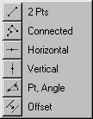

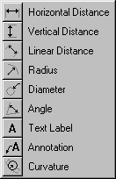




Geometry Constructors
Li
nes Fly
-
out
Circles Fly
-
out
Expand/Trim Fly
-
Dimensions Fly
-
out
out
Pick Fly
-
out
Fillets Fly
-
out
Arcs Fly
-
out
Points
Has no
fly
-
out

Slide 10

Lines
Line created with two endpoints.
Multiple lines created in succession. Endpoint of one line becomes start point of next line.
Infinite horizontal line created through a point.
Infinite vertical line created through a point.
Infinite line created through a point at an angle specified in degrees.
Line, circle or arc created offset from another. New lines have the same length as original.

Slide 11
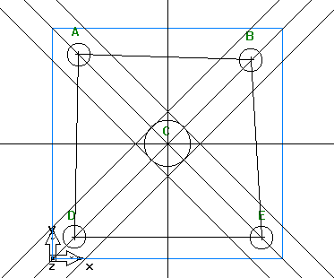
Lines Exercise lines_example.fm
Use a 2 point Line to create a line from A-B ** Hint – turn on snap to circle/center
Use a 2 point Line to create a line from A-D
Now use a connected line to create a line from B-E-D.
Use the horizontal line to place a line through C.
Use the vertical line tool to place a line through C.
Use the pt-angle line to make a 45 deg line through C.
Use the pt-angle line to make a 135 deg line through C.
Use the offset to offset line A-C-E .45 inches on each side.
Use the offset to offset line B-C-D .45 inches on each side.
Notes:
Open Lines_example.fm and follow instruction on screen:
Use a 2 point Line to create a line from A-B ** Hint – turn on snap to circle/center
Use a 2 point Line to create a line from A-D
Now use a connected line to create a line from B-E-D.
Use the horizontal line to place a line through C.
Use the vertical line tool to place a line through C.
Use the pt-angle line to make a 45 deg line through C.
Use the pt-angle line to make a 135 deg line through C.
Use the offset to offset line A-C-E .45 inches on each side.
Use the offset to offset line B-C-D .45 inches on each side.

Slide 12
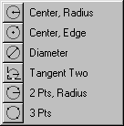
Circles
Center point and radius.
Center point and a point on the circle edge
Two points that indicate the diameter. Center is the point mid-way between
Circle created by snapping the circle's edge tangent to two objects
Two points and a radius
Three points on the circle

Slide 13
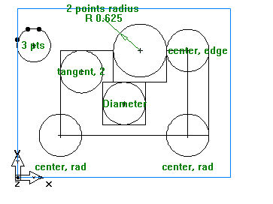
Circles Exercise circles_ex2.fm
Snap to the lower left & right corners of the part. Using the center radius tool, make a .5 in radius circle at each corner.
  Make sure you have the snap to endpoint, circle center, and intersection buttons activated.
Now go to the upper right. Use the center, edge to create a circle there.
Use the diameter circle constructor to make the circle in the center of the middle box.
Use the tangent to 2 points to create the circle at the upper left corner.
Using 2points- radius, make a circle with a .625 radius as shown.
Using the 3 points circle constructor, make a circle through the 3 points shown. *** Hint – turn on “SNAP TO POINT”.
Notes:
Open circles_ex2.fm
Snap to the lower left & right corners of the part. Using the center radius tool, make a .5 in radius circle at each corner.
Make sure you have the snap to endpoint, circle center, and intersection buttons activated.
Now go to the upper right. Use the center, edge to create a circle there.
Use the diameter circle constructor to make the circle in the center of the middle box.
Use the tangent to 2 points to create the circle at the upper left corner.
Using 2points- radius, make a circle with a .625 radius as shown.
Using the 3 points circle constructor, make a circle through the 3 points shown. *** Hint – turn on “SNAP TO POINT”.

Slide 14

Arcs
Arc created from start, median, and finish point.
Arc created from two points and radius.
Arc created from two end points and center point.

Slide 15
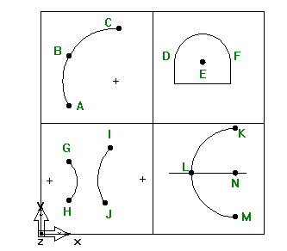
Arc Exercise
Use the 3 pts arc constructor to make the arc ABC.
  hint – turn on the snap functions “snap to point”.
Use the Center, Beg, End constructor to make the arc DEF using point “E” as the Center. ***
  hint – turn on the snap function “snap to endpoint”.
Use the arc constructor 2 Pts, Radius to make arc GH with a radius of 1.25”
Use the arc constructor 2 Pts, Radius to make arc IJ with a radius of 2”.
Use the arc constructor Center, Rad, Beg, End to make an arc with a 2” radius, center at point N, Beg Angle 90 deg (point K), and End Angle 270 deg (point M).
Notes:
Open arcs_example.fm
Use the 3 pts arc constructor to make the arc ABC.
hint – turn on the snap functions “snap to point”.
Use the Center, Beg, End constructor to make the arc DEF using point “E” as the Center. ***
hint – turn on the snap function “snap to endpoint”.
Use the arc constructor 2 Pts, Radius to make arc GH with a radius of 1.25”
Use the arc constructor 2 Pts, Radius to make arc IJ with a radius of 2”.
Use the arc constructor Center, Rad, Beg, End to make an arc with a 2” radius, center at point N, Beg Angle 90 deg (point K), and End Angle 270 deg (point M).

Slide 16

Fillets
Fillet arc created at intersection between two objects, tangent and trims excess geometry. One mouse click.
Fillet arc created between two objects, tangent and trims excess geometry. Two mouse clicks.
Fillet arc from three points, tangent and trims excess geometry. Three mouse clicks.

Slide 17
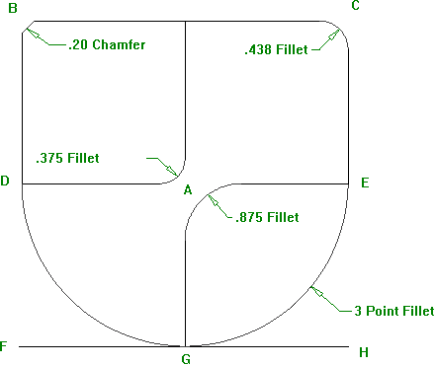
Fillets Exercise fillet_example.fm
Use the chamfer command to place a .20” chamfer at corner B.
Now use the 3 pt fillet command to place a fillet along D-G-E.
Use the 2 pt fillet command to place a .375” fillet at A with D as shown.
Use the corner fillet command to place a 7/16” (.438) fillet at corner C.
Use the 2 pt fillet command to place a 7/8 (.875)” fillet at corner G-A-E.
Notes:
Open fillet_example.fm
Use the chamfer command to place a .20” chamfer at corner B.
Now use the 3 pt fillet command to place a fillet along D-G-E.
Use the 2 pt fillet command to place a .375” fillet at A with D as shown.
Use the corner fillet command to place a 7/16” (.438) fillet at corner C.
Use the 2 pt fillet command to place a 7/8 (.875)” fillet at corner G-A-E.

Slide 18

Trim/Extend
Clips the highlighted geometry between two
Trims or extends highlighted geometry between first and second mouse picks
Changes a line or arc to become infinite.
Notes:
Open clip_example.fm

Slide 19

Dimensions
Horizontal dimension from two points.
Vertical dimension from two points.
Distance dimension from two points.
Radial dimension from circle or arc.
Diameter dimension from circle or arc.
Angular dimension from two lines.
Text label at any point.
Text label and arrow at any point and also a shortcut for determining XYZ locations.
Shows curvature at a point on surface.

Slide 20
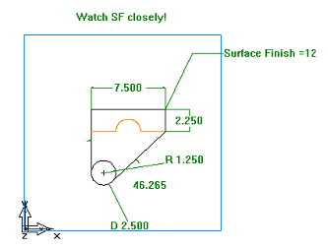
Dimensions Example dimension_ex.fm
Use the tools on the dimension toolbar to create the following dimensioned drawing
Notes:
Open dimension_ex.fm
Use the tools on the dimension toolbar to create the following dimensioned drawing

Slide 21
Curves
Curves are used to define the shape of many features
They are often formed by combining lines and arcs using chaining
Other methods are also available

Slide 22
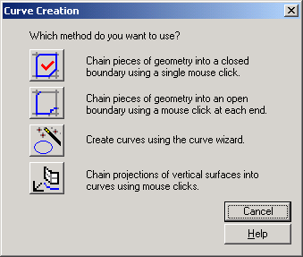
Curve Step
Closed curve chaining
Open curve chaining
Curve wizard
  Access to many other curve creation techniques

Slide 23
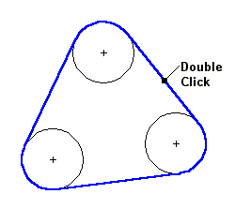
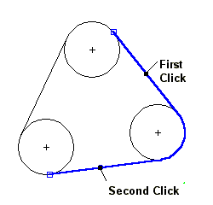
Chaining
Works only with lines and arcs (not curves)
Closed curve chaining
  Double click on line or arc
  Smooth path is preferred (no need to trim)
Open curve chaining
  Multiple picks required to guide the curve

Slide 24
Curve Wizard
The Curve Wizard allows you to make curves without drawing geometry first and chaining it together.
Curve from Curve – Join
  The Join command is like a “Super Chaining” command. It will join multiple curves together, and jumps gaps.
Curve from Other Methods – Text
  You can create a curve from any True Type font installed on your computer.
  FeatureCAM includes 2 single line engraving fonts for your convenience.

Slide 25
Trouble Shooting Curves
By default, geometry must be planar to chain into curves. Use the Unrestricted button to chain a 3D curve.
Increase the depth if there are hundreds of small pieces of geometry to chain together.
Set the tolerance to chain across small gaps or breaks in the geometry.
Overlapping or duplicate Geometry can cause problems.

Slide 26
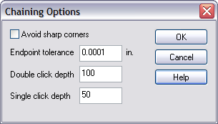
Chaining Importing Geometry
DWG Polyline entities, are imported as Curves into FeatureCAM
  Curve join must be used to combine with other curves
Gap handling
  Use the endpoint tolerance option to allow FeatureCAM to jump the gaps.
  Join is sometimes required
Delete all duplicates before chaining your curves.
Notes:
Click Chaining Options from the Options menu to access the Chaining Options dialog box.
Click help to get information on the other parameters listed.

Slide 27
Importing Layers
FeatureCAM will import all associated layers with the imported geometry.
Entities can be grouped by layer and then the layer can be made viewable or not viewable to control what the user sees on the screen.

Slide 28
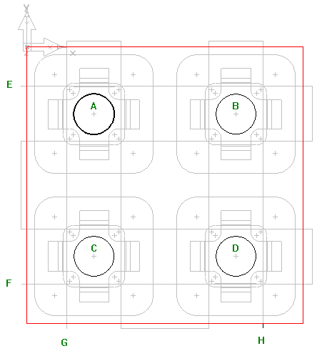
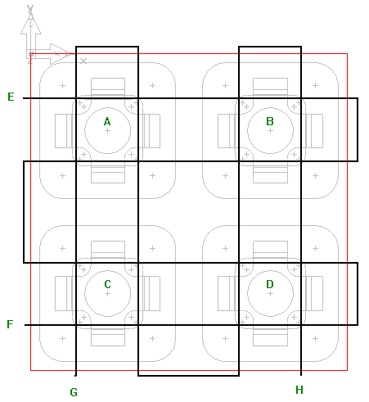
Curve Exercise curve_chaining.fm
Use Closed Curve to create 4 curves by single click chaining the circles at points A, B, C, &D. Name the curves – NW_circle, NE_circle, SE_circle, & SW_circle.
Use Pick Curve Pieces and single click chaining to create two Zigzag curves between E and F; G and H.
Notes:
Open curve_chaining.fm
Use Closed Curve to create 4 curves by single click chaining the circles at points A, B, C, &D. Name the curves – NW_circle, NE_circle, SE_circle, & SW_circle.
Use Pick Curve Pieces and single click chaining to create two Zigzag curves between E and F; G and H.

Slide 29
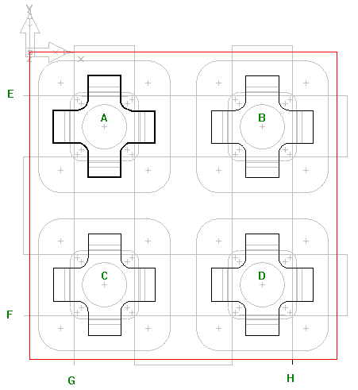
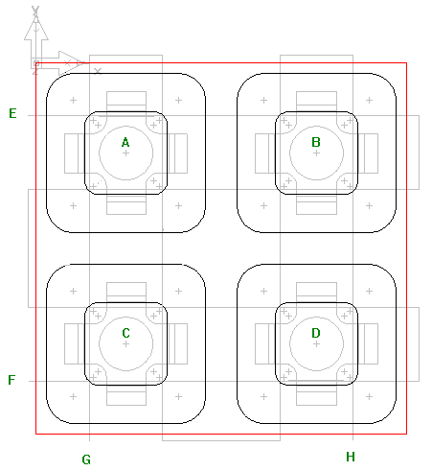
Curve Exercise curve_chaining.fm
Use Closed Curve to create 4 curves shaped like a cross by single click chaining around points A, B, C, &D. Use Pick Curve Pieces and single click chaining to create two Zigzag curves between E and F; G and H.
Use Pick Curve Pieces and double click chaining to chain the larger rectangles around points A, B, C, &D. Name the curves – NW_rect, NE_rect, SE_rect, and SW_rect.

Slide 30
Course Review
Snapping
Geometry
  Lines, circles, arcs, fillets, dimensions
Curves
  Chaining
  Joining
  Imported geometry

Slide 31
Questions?

